Slide 1
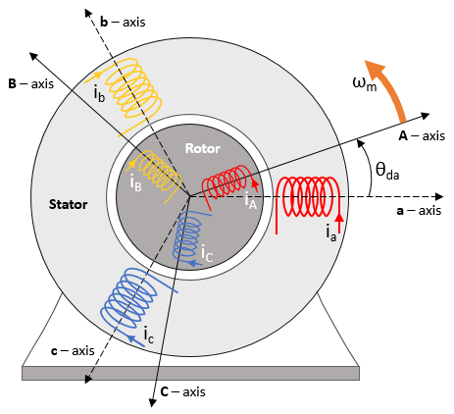


Fault Detection Of Induction Motor Using Machine Learning And Signal Processing
BEE-13A
Group members:
Muhammad Samiullah Hasan Ali Shehryar Zahoor Anas Ali

Slide 2
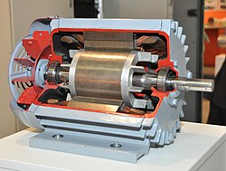
INTRODUCTION
Induction motors play a crucial role in powering industrial machinery.
Reliable motor operation is vital for productivity and safety.
Motor faults can lead to downtime, increased maintenance costs, and compromised efficiency.
Our objective is to develop a system for early fault detection in induction motors.
Utilize machine learning and signal processing for accurate and automated fault detection.

Slide 3
Simulink Model Design & Workflow
Constructed a three phase induction motor on Simulink.
Generated following faults in the motor:
Stator Open Circuit: Break in the electrical circuit.
Stator Short Circuit: Inter-turn current bypassing.
Motor Overload: Excessive current is drawn, surpassing limits.
Broken Rotor Bar: Physical damage to rotor bars affecting motor performance.

Slide 4
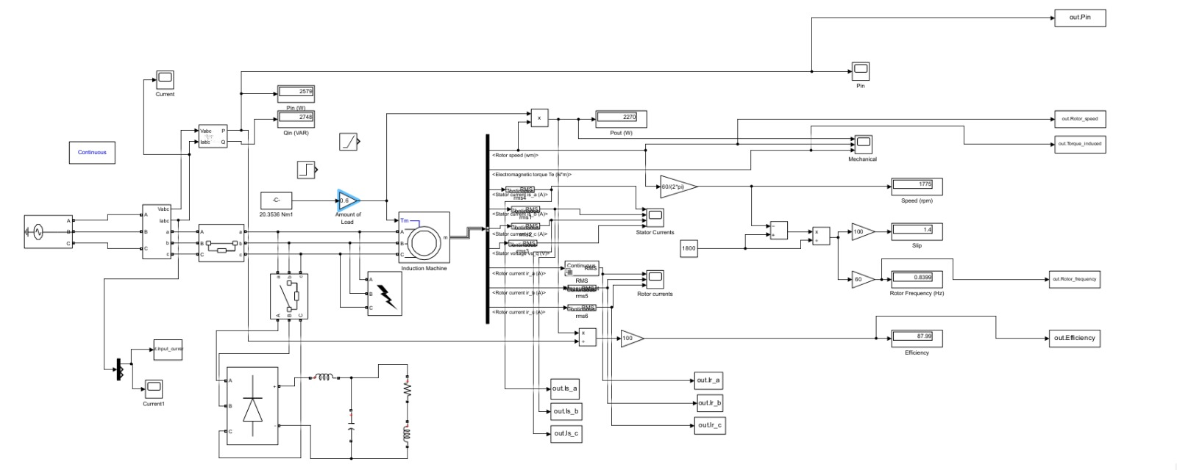
Simulink Model

Slide 5
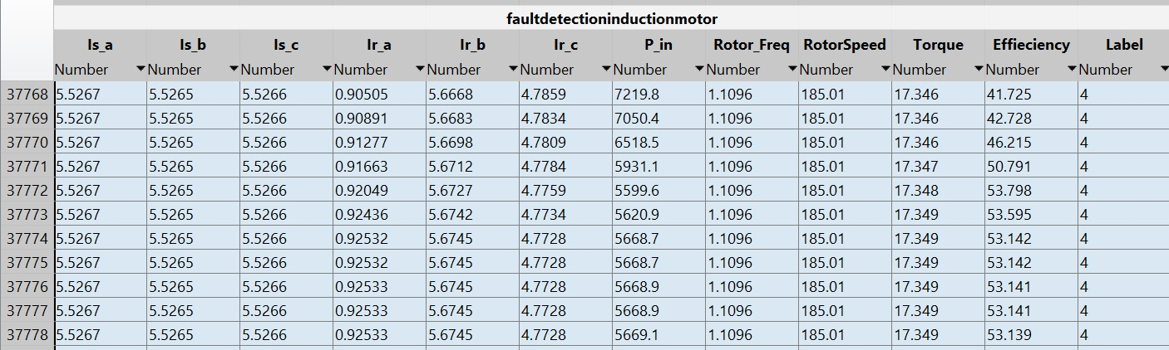
Simulink Model Design & Workflow
Collected data of 150,000 data points with 60-40% ratio of healthy to faulty motor data.
Following parameters were considered for data collection
Stator Currents
Rotor Currents
Input Power
Slip
Rotor Speed
Efficiency

Slide 6
Simulink Model Design & Workflow
Divided the data into training and test set with 70-30% ratio.
Trained different machine learning models on the generated dataset.
Compared the accuracy of the models on test set.
Chose the model with best results.

Slide 7
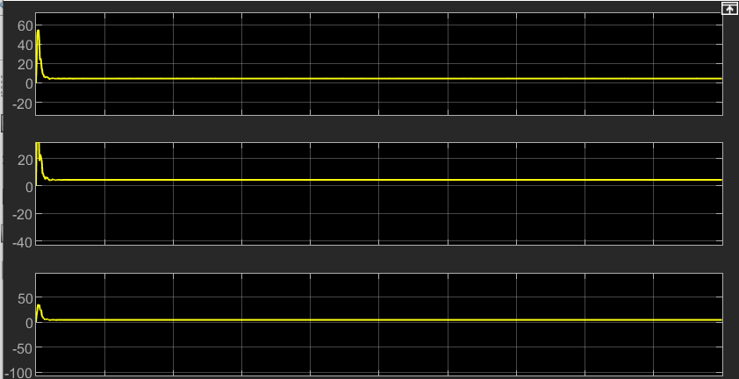
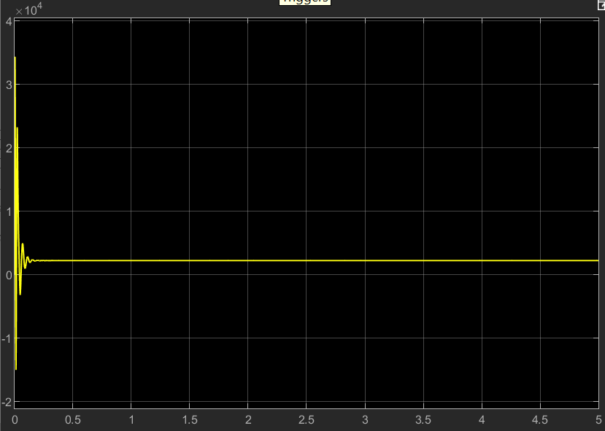
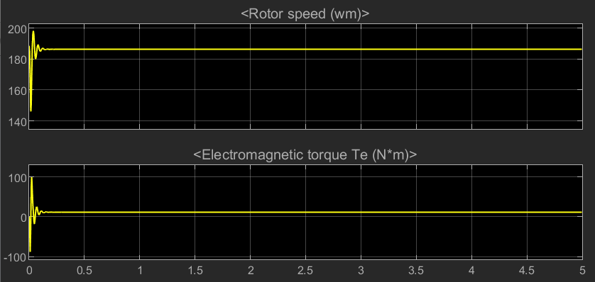
Normal Motor
Stator Currents
Input Power

Slide 8
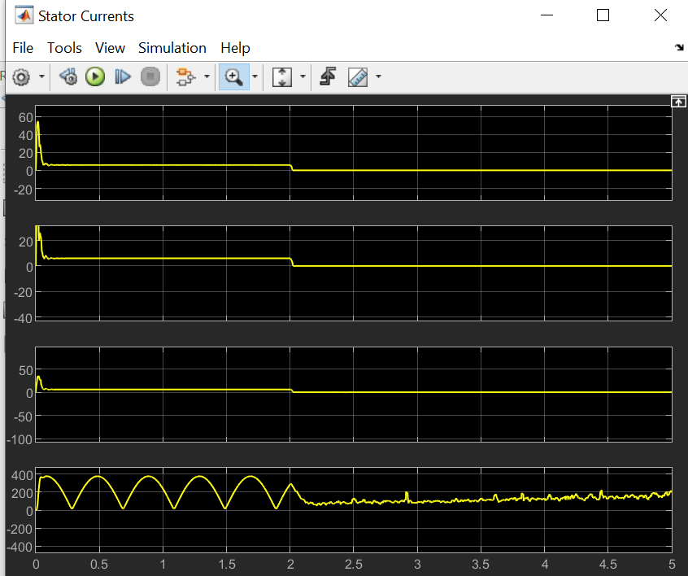
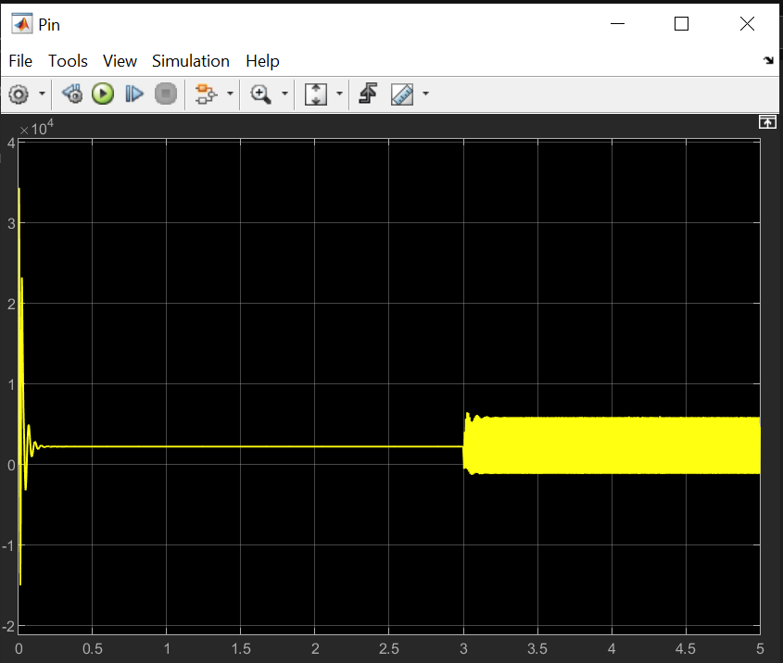
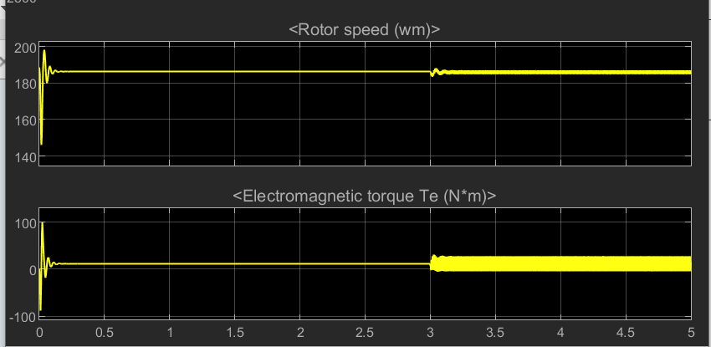
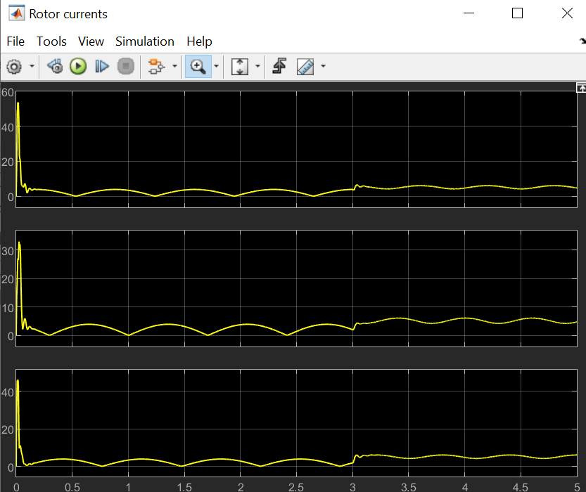
Open Circuited
Stator Currents
Input Power
Rotor Currents

Slide 9
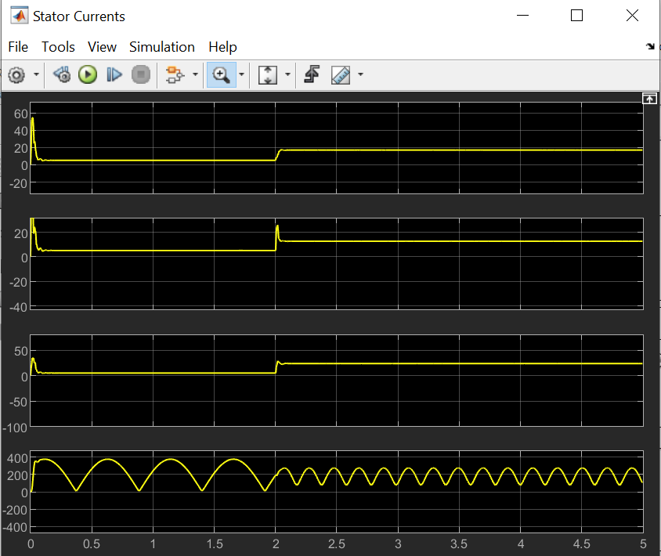
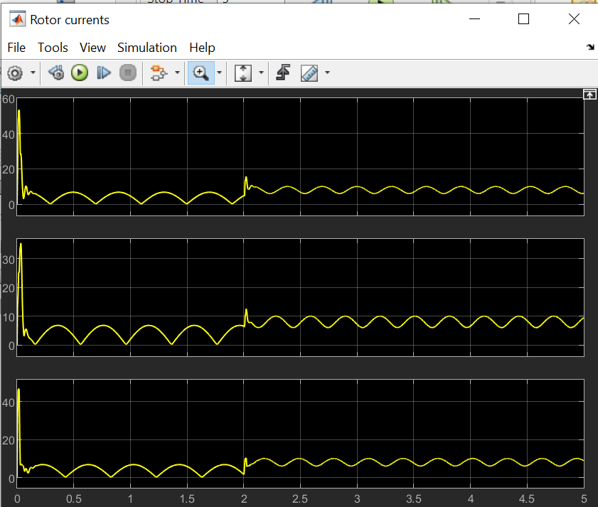
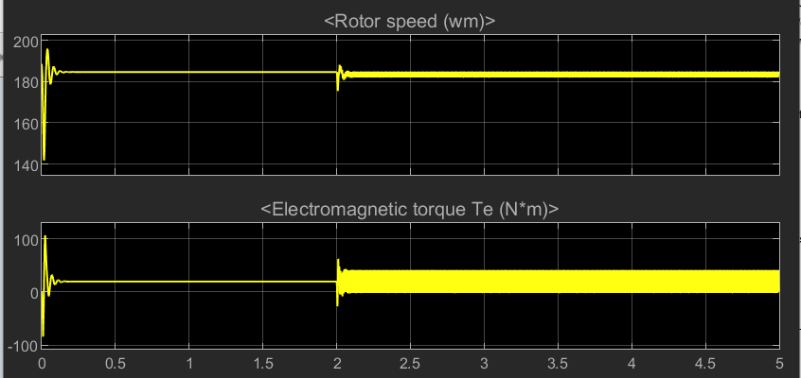
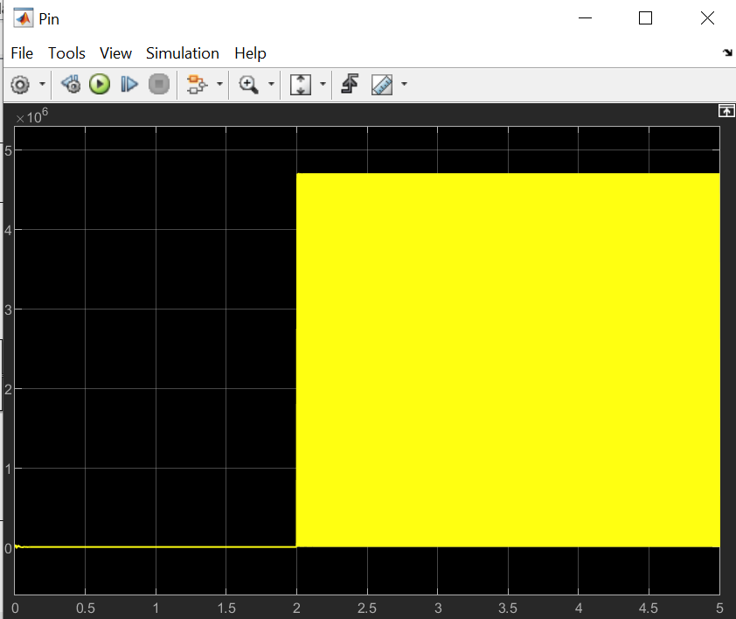
Short circuit
Stator Currents
Rotor Currents
Input Power

Slide 10
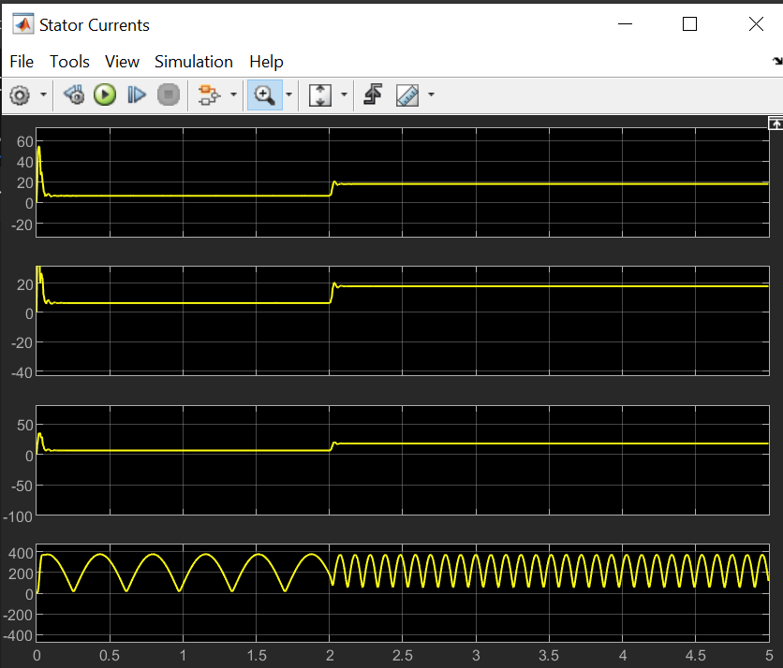
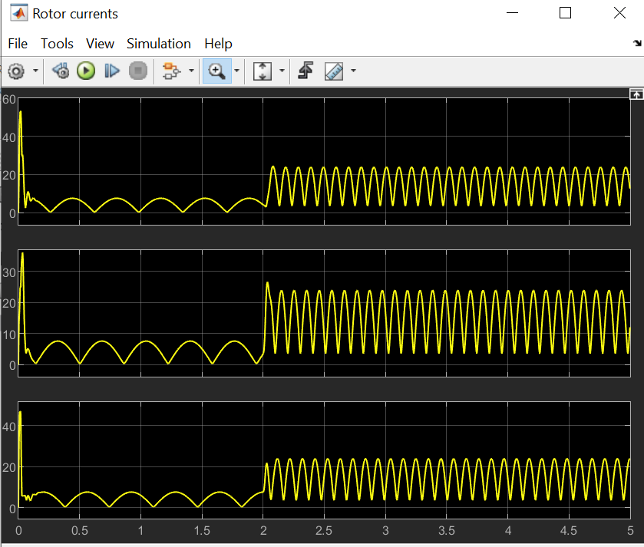
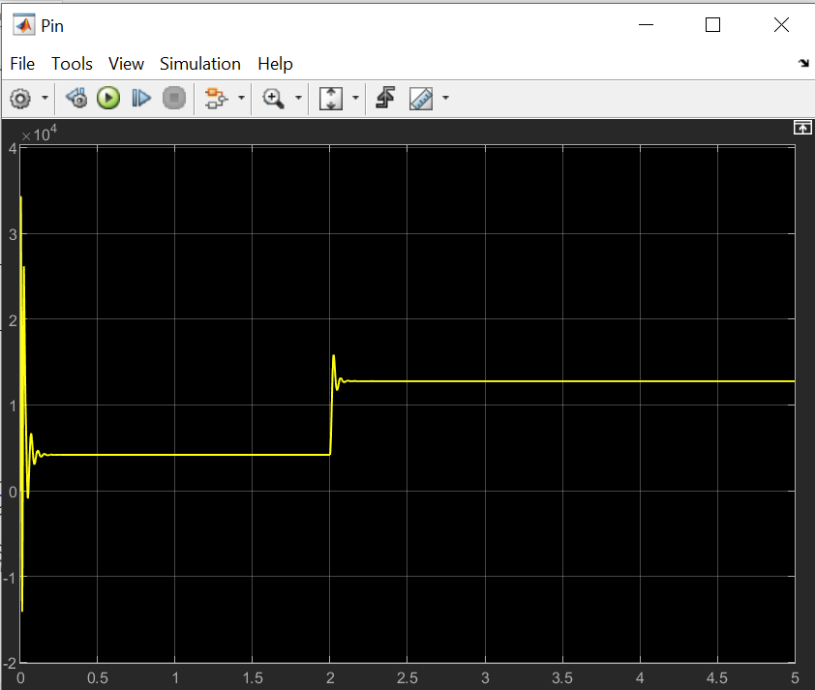
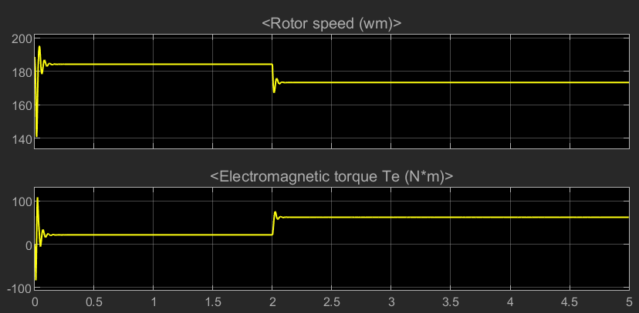
Overload
Stator Currents
Rotor Currents
Input Power

Slide 11
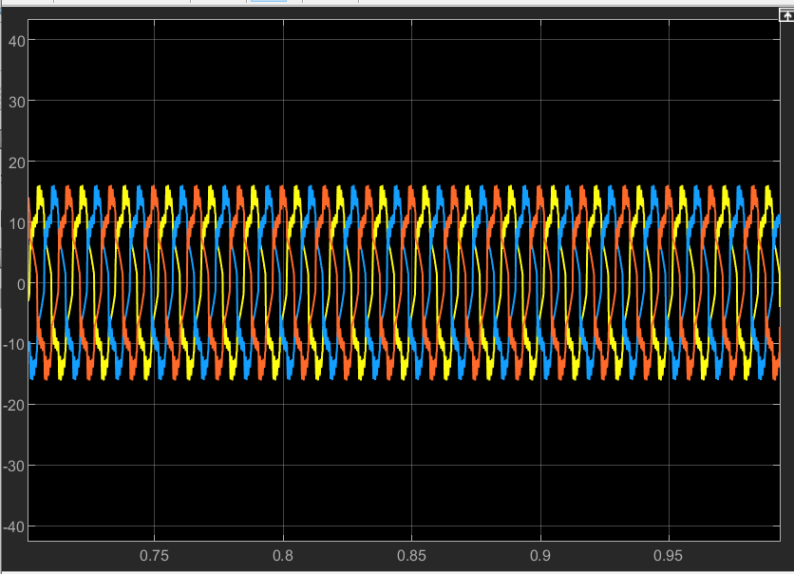
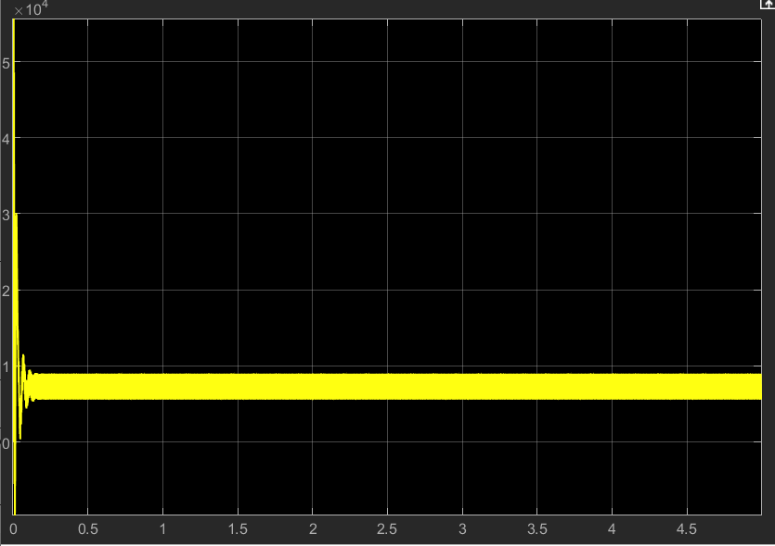
Rotor bar broken
Stator Currents
Input Power

Slide 12
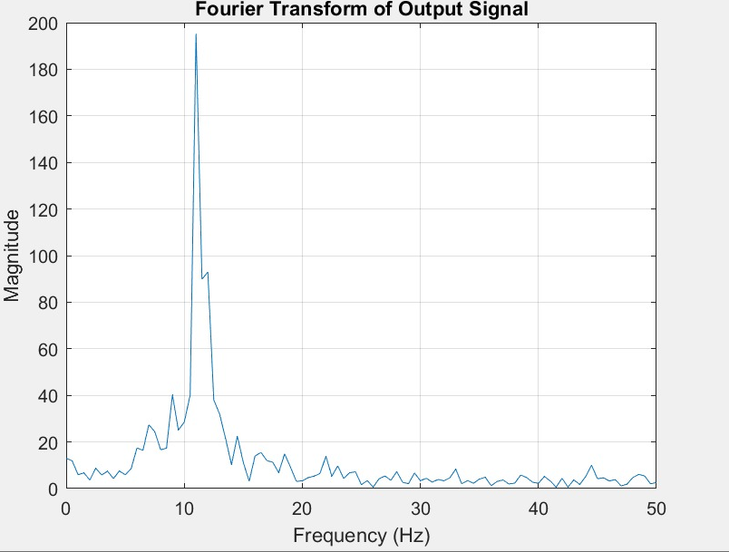
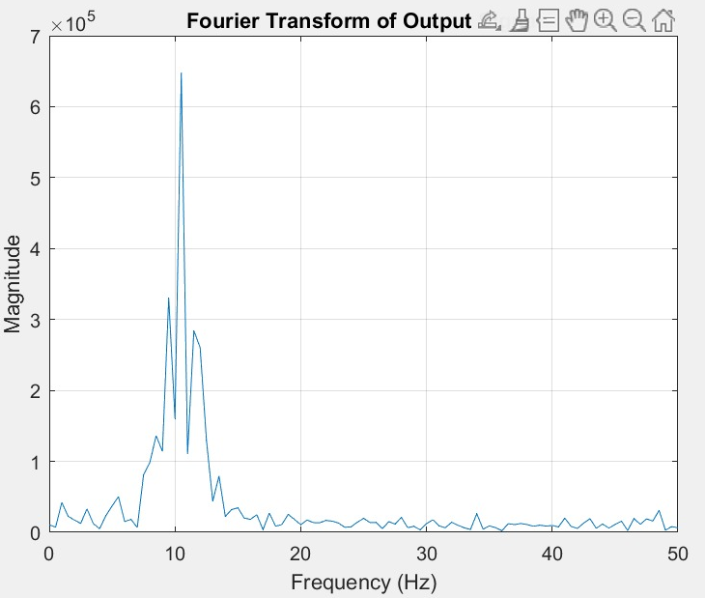
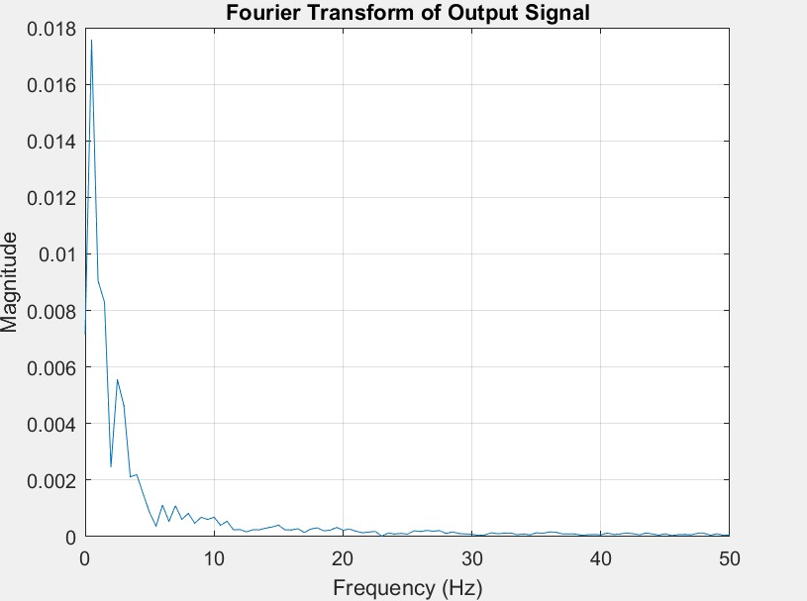
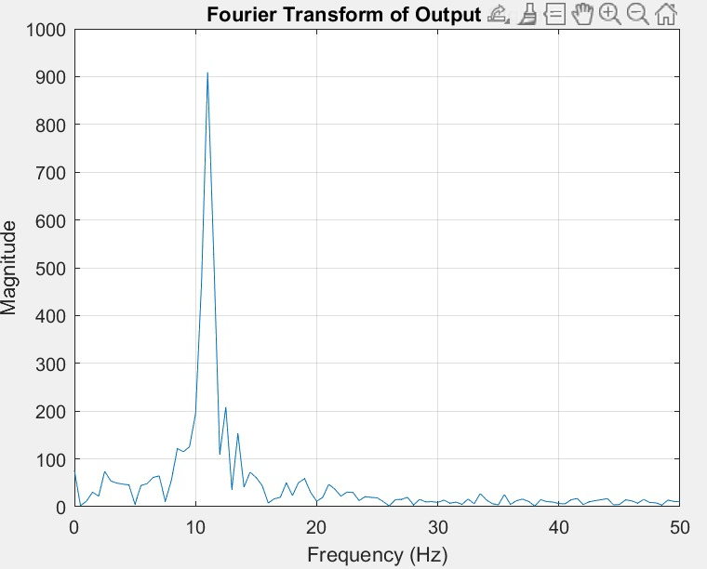
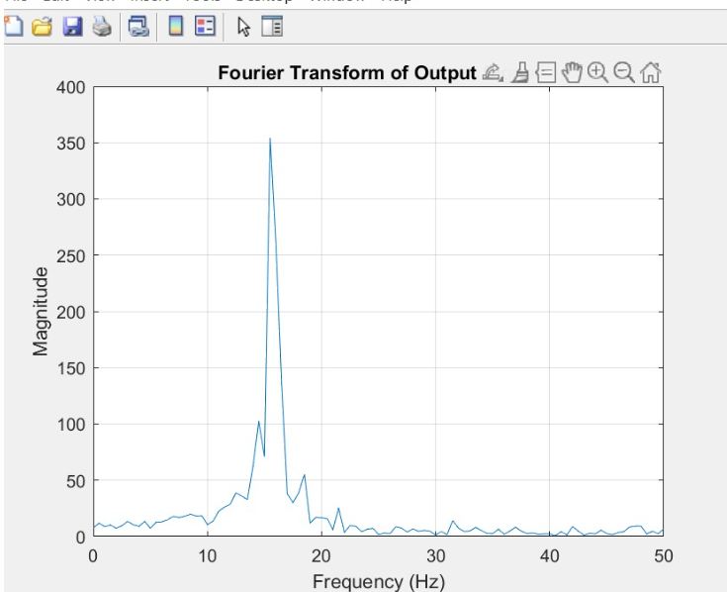
Short-
Circuit
Healthy
Open-
Circuit
Overload
Broken Rotor Bar

Slide 13
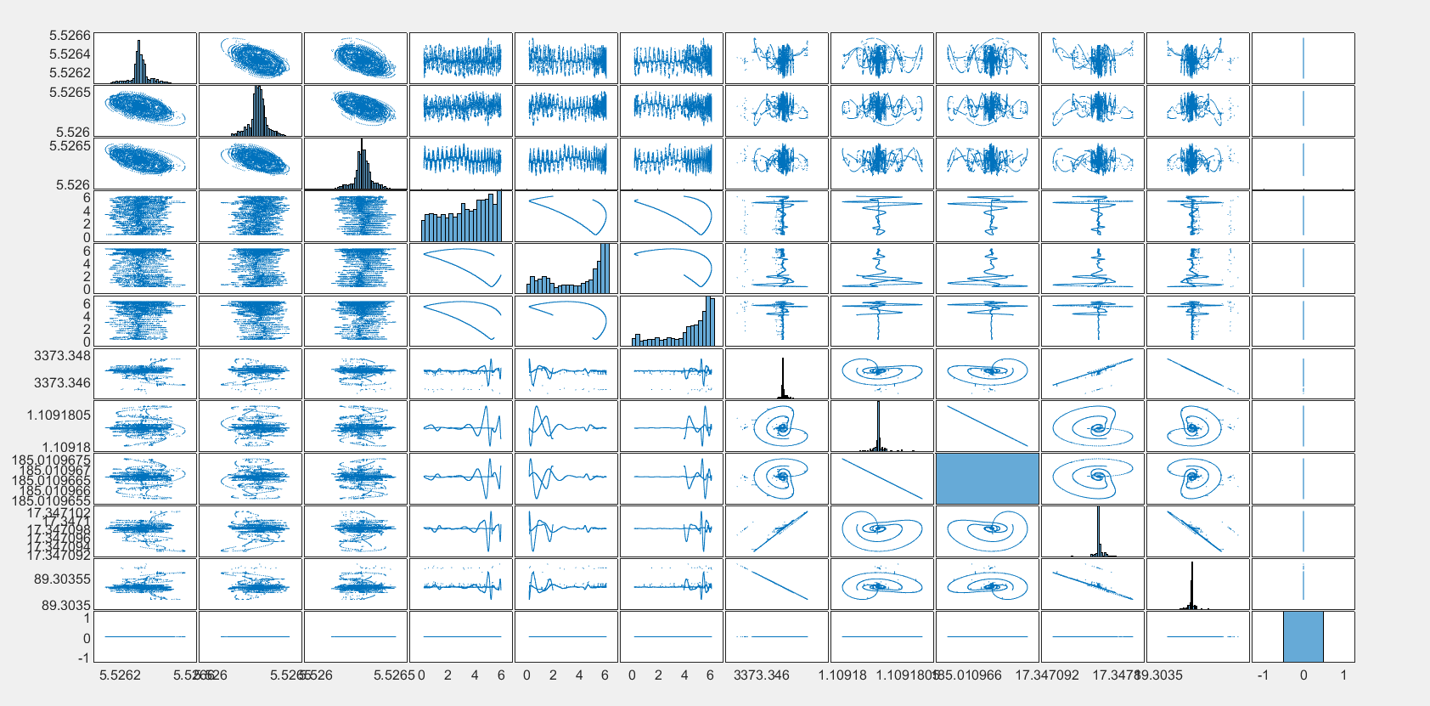
Plot Matrix

Slide 14
Performance of Machine Learning Models
Model | Accuracy | Recall | F1 Score
Decision Trees | 92.1 | 0.95 | 1.13
Logistic Regression | 61.3 | 0.43 | 0.87
Naïve Bayes | 42.8 | 0.78 | 1.07
K-Nearest Neighbors (KNN) | 52 | 0.63 | 0.8
Support Vector Machines (SVM) | 63 | 0.74 | 0.6

Slide 15

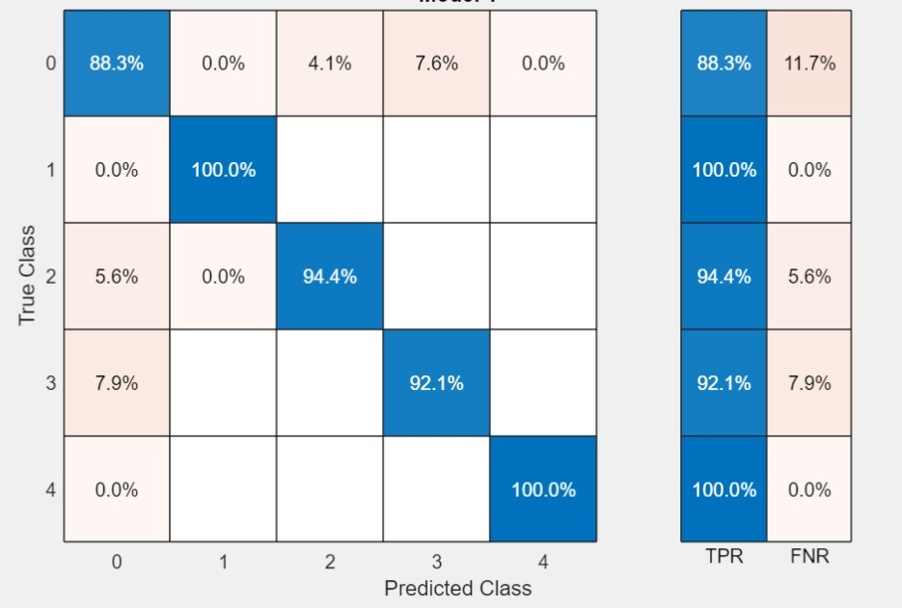
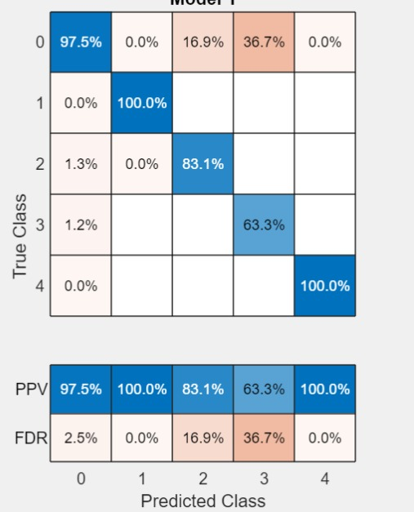
Decision Trees
Confusion Matrix

Slide 16
Conclusion
Enhanced motor reliability and reduce maintenance costs.
Improve overall system efficiency through early fault detection.
Machine learning's adaptability to complex patterns suits the varied conditions of motor operation.
Aligns with trends in predictive maintenance and smart technologies in industrial automation.

Slide 17
Research Areas
Explore advanced signal processing methods for extracting relevant features from motor operation data, such as time-domain and frequency-domain analysis.
Develop techniques for continuous condition monitoring of induction motors, leveraging both real-time and historical data to identify subtle changes indicative of faults.
Research methods to quantify the severity of detected faults, providing insights into the urgency and extent of required maintenance.

Slide 18
References
Fault Detection of Induction Motor Using Fast Fourier Transform with Feature Selection via Principal Component Analysis by Young Jun Yoo
Fault detection and diagnosis in induction motor using artificial intelligence technique by M.S. Khireddine, N. Slimane, Y. Abdessemed, and M.T. Makhloufi
Fault detection in induction motors based on artificial intelligence by Vinicius A. D. Silva and Robson Pederiva

Slide 19


